Slide 1
PSCS_76_E-Waste Facility Locator
CSE7101- Capstone Project
Review-1
Batch Number: CSE_224
Under the Supervision of,
Dr.Thrimoorthy N
Assistant Professor
School of Computer Science and Engineering
Presidency University
Roll Number | Student Name
20221CSE0626 | THEJAS C
20221CSE0624 | T M TEJASHWINI
20221CSE0628 | VINAY K HIREMATH
Name of the Program: CSE7101 - Capstone Project
Name of the HoD: Dr. Asif Mohammed, Dr. Blessed Prince
Name of the Program Project Coordinator: Dr. Jayavadivel Ravi, Mr.Muthuraju V
Name of the School Project Coordinators: Dr. Sampath A K , Dr. Geetha A

Slide 2
Content
Problem Statement
Analysis of Problem Statement
Git-hub Link
Timeline of the Project
References

Slide 3
Problem Statement Number: 76
Organization: Ministry of Environment
Category (Hardware / Software / Both) : Software
Problem Description: Website that tells you the location of the nearest e-waste collection and recycling facility. Offers educational pop-ups on the harmful components of your e-waste and their effects on the environment and human health if not disposed correctly. There could be an option to input the model of your old device and earn credit points relative to the amount of precious metals recovered from the device if disposed correctly.

Slide 4
Analysis of Problem Statement
Technology Stack Components:
Layer | Technology
Frontend | HTML5, Tailwind CSS
Backend | Node.js + express.js
Database | MySQL
Deployment (optional) | AWS

Slide 5
Analysis of Problem Statement (contd...)
Understanding the E-Waste Challenge:
Rapid increase in electronic consumption → surge in e-waste.
Improper disposal leads to environmental and health hazards.
Lack of awareness and access to proper recycling facilities.
Need for a solution that is accessible, educational, and incentivized.

Slide 6
Analysis of Problem Statement (contd...)
Proposed Solution and Functional Overview:
Web platform to locate nearest e-waste collection centers.
Educational pop-ups about harmful components and their effects.
Input device model → estimate recoverable metals → earn credit points.
Encourages responsible disposal through awareness and rewards.

Slide 7
Analysis of Problem Statement (contd...)
Expected Impact and Benefits:
Reduction in toxic waste entering landfills.
Increased recovery of precious metals like gold, silver, and palladium.
Greater public awareness of e-waste hazards.
Incentivized disposal encourages participation.
Credit point system could evolve into discounts or loyalty rewards.

Slide 8
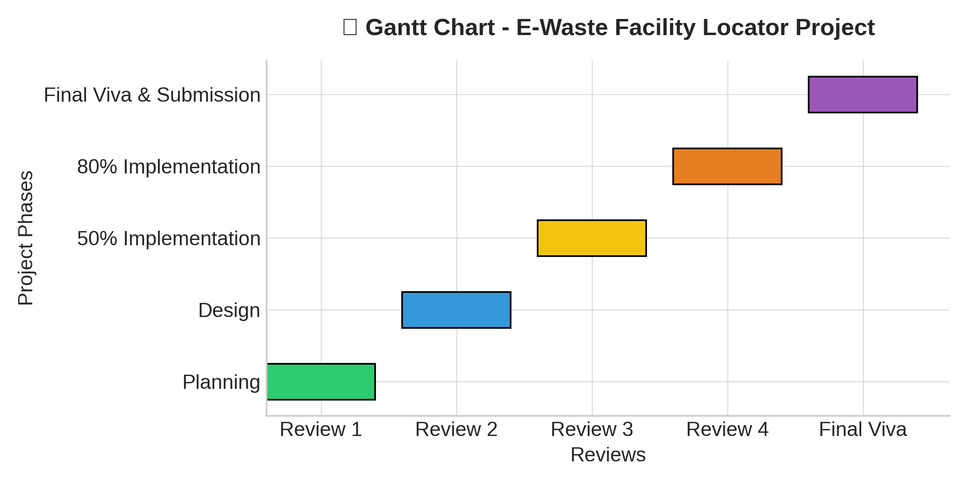
Timeline of the Project (Gantt Chart)

Slide 9
Github Link
The Github link provided should have public access permission.
Github Link:
https://github.com/thejas-c/E-Waste-Facility-Locator

Slide 10
References (IEEE Paper format)
[1]. S. Sharma, R. Gupta, and A. Verma, “Metal recovery from e-waste by recycling techniques: A review,” Proc. 8th Int. Conf. Smart Structures and Systems (ICSSS), pp. 1–6, Apr. 2022.
[2]. B. Abdelazeem et al., “The effectiveness of incentives for research participation: A systematic review and meta-analysis of randomized controlled trials,” PLoS ONE, vol. 17, no. 4, pp. e0267534, Apr. 2022.

Slide 11


